Slide 1

Consumer Goods
Ad_Hoc Insights
Data analytics approach
Hiralal Patra
ATLIQ HARDWARE

Slide 2
Contents
About Company
Company product lines
About dataset
Problem statement
Ad_hoc request with insights

Slide 3
ABOUT COMPANY
Atliq Hardware is one of India's leading computer hardware producers.
Our company business also expanded to other 26 countries all over the world.
We have 74 customers across the world like Flipkart, Croma and Vijay sales.

Slide 4
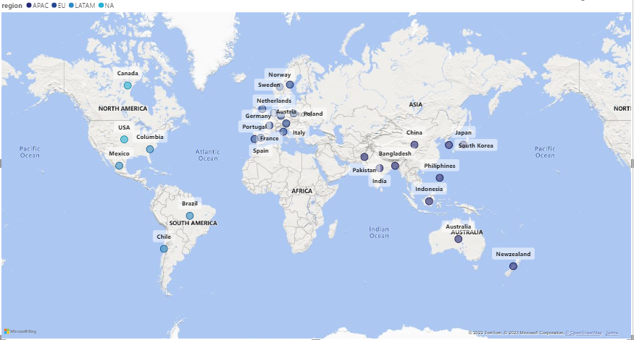
Atilq hardware company actively doing business In these 27 countries.

Slide 5
Company product lines :
PC
Notebook & Desktop
DESKTOP
NOTEBOOK
P&A
Peripherals & Accessories
PERIPHERAL
ACCESSORIES
NETWORKING
N&S
Networking & Storage
STORAGE
WIFI EXTENDER
EXTERNAL SSD
USB FLASH DRIVE
BATTERIES
KEYBOARD
MOUSE
GRAPHIC CARD
INTERNAL HDD
MOTHERBOARD
PROCESSORS
GAMING LAPTOP
BUSINESS LAPTOP
PERSONAL LAPTOP
BUSINESS LAPTOP
PERSONAL LAPTOP

Slide 6
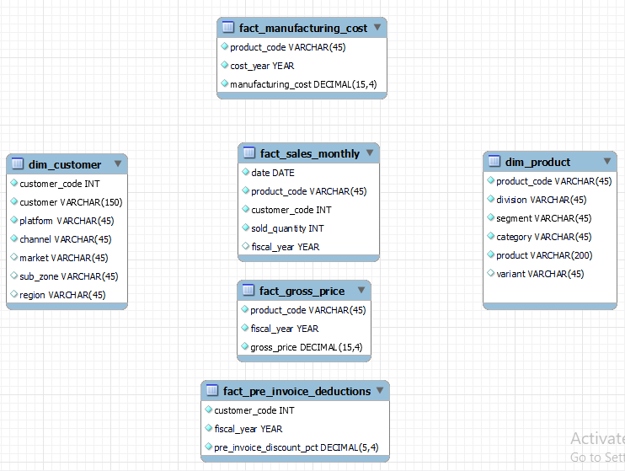
About dataset
1. dim_customer:
Contains customer-related data
2. dim_product:
Contains product related data
3. fact_gross_price:
Contains gross price information for
each product
4. fact_manufacturing_cost:
Contains the cost incurred in the
production of each product
5. fact_pre_invoice_deductions:
Contains pre-invoice deductions
information for each product
6. fact_sales_monthly:
Contains monthly sales data for
each product.

Slide 7
Problem statement :
The management noticed that they do not get enough insights to make quick and smart data-informed decisions.
There are 10 ad hoc requests for which the company need insights so that management can take the future decision to scale their business.

Slide 8
Ad_hoc request with insights

Slide 9
Requests 1:
Market
India
Indonesia
Japan
Philiphines
South Korea
Australia
Newzealand
Bangladesh
Provide the list of markets in which customer "Atliq Exclusive" operates its business in the APAC region.

Slide 10
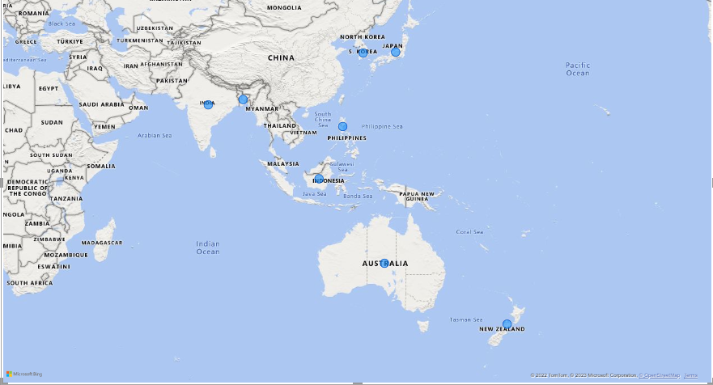
Insights

Slide 11
Requests 2:
unique_count_in2020 | unique_count_in2021 | percentage_change
245 | 334 | 36.33%
What is the percentage of unique product increase in 2021 vs. 2020? The final output contains these fields,
unique_products_2020 unique_products_2021 percentage_chg

Slide 12
Insights
There are 36.33% of unique products after 2020 in 2021, this is a positive sign for the company.
This percentage change shows the interest of our end user in new products.

Slide 13
Requests 3:
segment | product_count
Notebook | 129
Accessories | 116
Peripherals | 84
Desktop | 32
Storage | 27
Networking | 9
Provide a report with all the unique product counts for each segment and sort them in descending order of product counts. The final outputcontains 2 fields,
segment
product_count

Slide 14
Insights
According to the visual, Notebook has the highest number of unique products which are personal laptops, gaming laptops and business laptops so on.
Accessories has the second highest unique products which are sub selling segment of Notebook.
Networking has the least products

Slide 15
Requests 4:
segment | product_count_2020 | product_count_2021 | difference
Peripherals | 59 | 75 | 16
Accessories | 69 | 103 | 34
Notebook | 92 | 108 | 16
Desktop | 7 | 22 | 15
Storage | 12 | 17 | 5
Networking | 6 | 9 | 3
Follow-up: Which segment had the most increase in unique products in 2021 vs 2020?
The final output contains these fields, segment
product_count_2020 product_count_2021 difference

Slide 16
Insights
If we look at this pie chart segment wise “ Accessories” has the highest number of unique products in 2021 as compared to 2020.
Networking, storage and Desktop have the least unique products. which is indicating less innovation in these segments.

Slide 17
Requests 5:
product_code | product | manufacturing_cost
A6120110206 | AQ HOME Allin1 Gen 2 | 240.5364
A2118150101 | AQ Master wired x1 Ms | 0.892
Get the products that have the highest and lowest manufacturing costs. The final output should contain these fields,
product_code product manufacturing_cost

Slide 18
Insights
The highest manufacture cost is “AQ HOME Allin1 Gen 2” which is 240.53
The lowest manufacture cost is “AQ Master wired x1 Ms” which is 0.892

Slide 19
Requests 6:
customer_code | customer | avg_dic_percentage
90002009 | Flipkart | 30.83%
90002006 | Viveks | 30.38%
90002003 | Ezone | 30.28%
90002002 | Croma | 30.25%
90002016 | Amazon | 29.33%
Generate a report which contains the top 5 customers who received an average high pre_invoice_discount_pct for the fiscal year 2021 and in the Indian market. The final output contains these fields,
customer_code
Customer
average_discount_percentage

Slide 20
Insights
From the line chart, these are the top 5 customers on average whom Altiq has given discounts in the fiscal year 2021 in the Indian market.
All customers share almost the same discount.

Slide 21
Requests 7:
year | month | gross_sales_amount
2020 | 9 | 4.5
2020 | 11 | 7.52
2020 | 12 | 4.83
2020 | 1 | 4.74
2020 | 3 | 0.38
2020 | 4 | 0.4
2020 | 5 | 0.78
2020 | 7 | 2.55
2020 | 8 | 2.79
2020 | 10 | 5.14
2020 | 2 | 4
2020 | 6 | 1.7
2021 | 9 | 12.35
2021 | 11 | 20.46
2021 | 12 | 12.94
2021 | 1 | 12.4
2021 | 3 | 12.14
2021 | 4 | 7.31
2021 | 5 | 12.15
2021 | 7 | 12.09
2021 | 8 | 7.18
2021 | 10 | 13.22
2021 | 2 | 10.13
2021 | 6 | 9.82
Get the complete report of the Gross sales amount for the customer “Atliq Exclusive” for each month. This analysis helps to get an idea of low and high-performing months and take strategic decisions. The final report contains these columns:
Month
Year
Gross sales Amount

Slide 22
Insights
November has the highest gross sales in both 2020 and 2021 year because of the festive session.
Company should focus on other months to increase their sales mainly in April and august.

Slide 23
Requests 8:
QUARTER | total_sold_quantity
Q1 | 7005619
Q2 | 6649642
Q3 | 2075087
Q4 | 5042541
In which quarter of 2020, got the maximum total_sold_quantity? The final output contains these fields sorted by the total_sold_quantity,
Quarter
total_sold_quantity

Slide 24
Insights
From this bar chart, we can see Q3 has the lowest sales so company should focus on marketing as compared to other Quarters.
In Q1 and Q2 has better sales quantity as compared to other Quarter because of festive season.

Slide 25
Requests 9:
channel | gross_sales_mln | percentage
Retailer | 1924.17 | 73.22
Direct | 406.687 | 15.47
Distributor | 297.176 | 11.31
Which channel helped to bring more gross sales in the fiscal year 2021 and the percentage of contribution? The final output contains these fields,
channel
gross_sales_mln
percentage

Slide 26
Insights
As we know Altliq has both B2B and B2C business plans. According to the pie chart, the majority of sales revenue comes from B2B.
In B2B plans,73% and 11% of sales revenue comes through retailers and distributors.
And remaining 16% of sales revenue comes from B2C business plan(Direct).

Slide 27
Requests 10:
division | product_code | product | total_sold | rank_order
N & S | A6720160103 | AQ Pen Drive 2 IN 1 | 701373 | 1
N & S | A6818160202 | AQ Pen Drive DRC | 688003 | 2
N & S | A6819160203 | AQ Pen Drive DRC | 676245 | 3
P & A | A2319150302 | AQ Gamers Ms | 428498 | 1
P & A | A2520150501 | AQ Maxima Ms | 419865 | 2
P & A | A2520150504 | AQ Maxima Ms | 419471 | 3
PC | A4218110202 | AQ Digit | 17434 | 1
PC | A4319110306 | AQ Velocity | 17280 | 2
PC | A4218110208 | AQ Digit | 17275 | 3
Get the Top 3 products in each division that have a high total_sold_quantity in the fiscal_year 2021? The final output contains these fields,
division
product_code
product total_sold_quantity
rank_order

Slide 28
Insights
N&S(Networking & Storage) products are highly sold compared to other divisions in fiscal year 2021.
In N&S, the top-selling product is AQ Pen Drive 2 IN 1 with 701373 quantities.
In P&A, the top-selling product is AQ Gamers Ms with 428498 quantities.
And in PC, division products are lowest-sold products as compared to other divisions which company needs to take some strategic decisions to improve sales of PC.

Slide 29
THANK YOU

